Slide 1
COVID19: The Expansion of Government Vaccination Programs
Judy Wilyman PhD
Independent Researcher and Educator

Slide 2
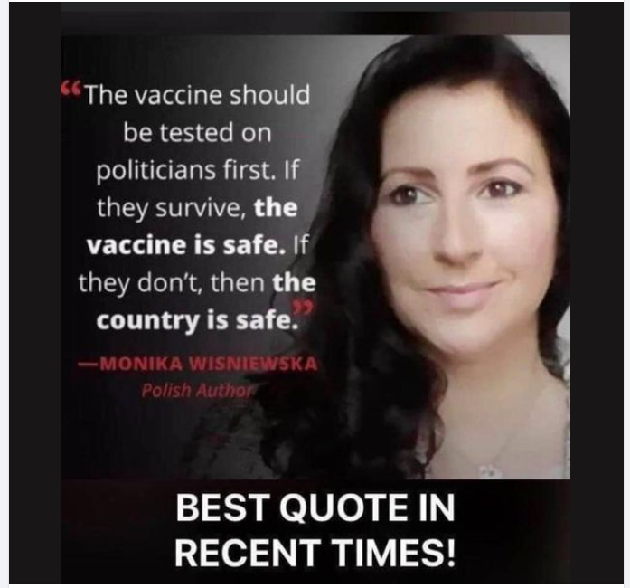
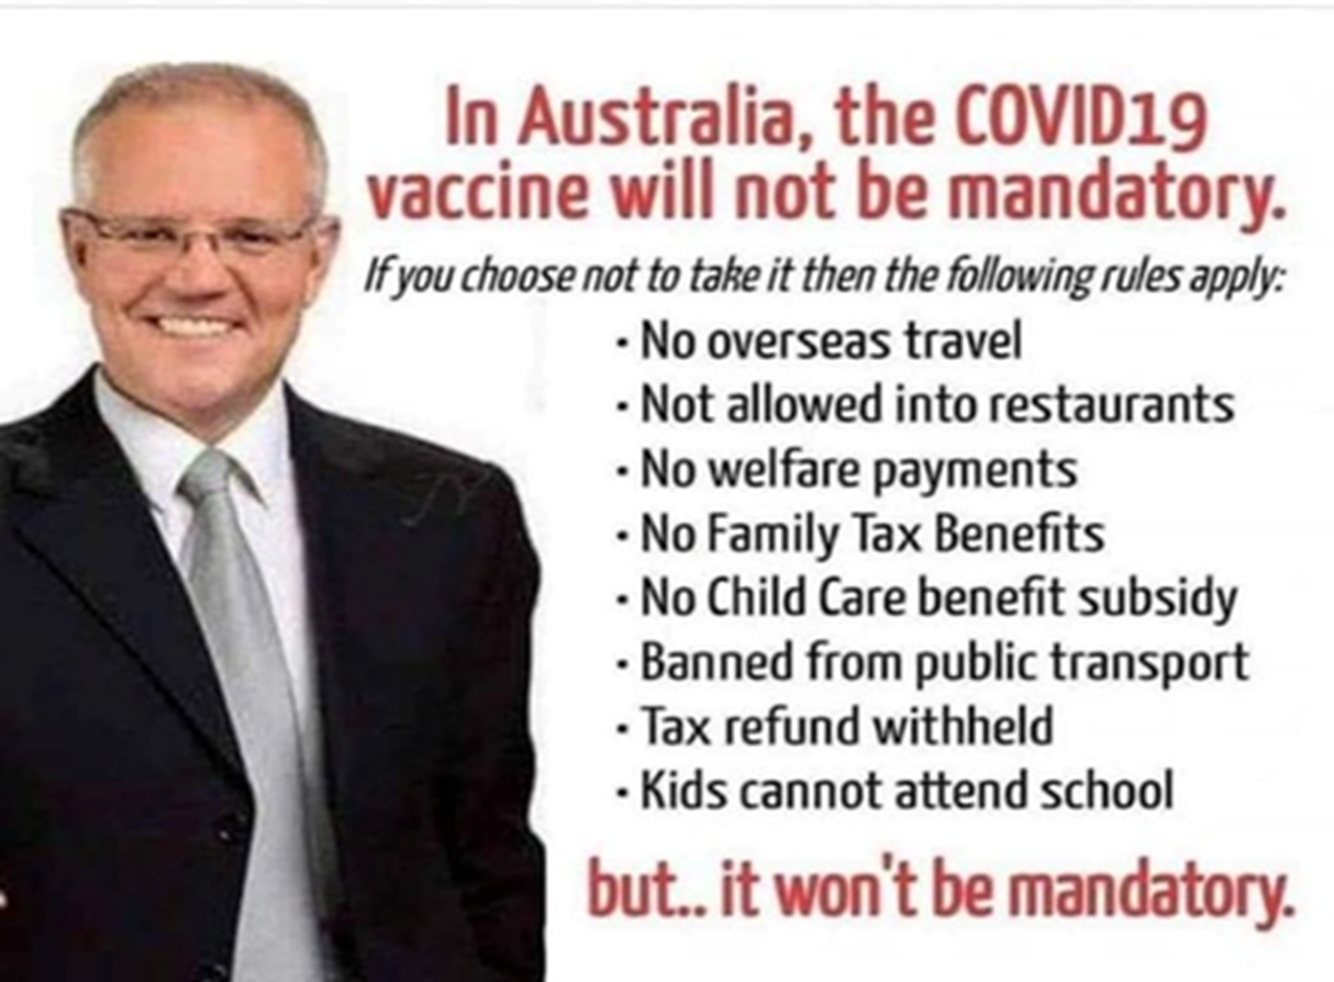

Slide 3
2020
A healthy person without any symptoms is now labelled a ‘case of disease’.
Healthy people are being treated as the cause of disease and are being locked up for 14 days and criminalised.
How has this happened?

Slide 4
1975 Merck’s Goal
Head of Merck in Fortune Magazine:
“it had long been his dream to make drugs for healthy people, so that Merck could sell to everyone”.
Gadsden’s dream now drives the marketing machinery of the most profitable industry on earth (Moynihan and Cassels 2005).

Slide 5
1986 Removal of Liability
Big Pharma - millions of dollars in compensation every year for vaccine injury claims and deaths
In 1986 Pharmaceutical Manufacturers requested indemnity for vaccine products
Contraindications (genetic pre-disposition) were removed from 1986 onwards.

Slide 6
Epigenetics
Reactions to vaccines vary according to GENETIC factors.
Some people are pre-disposed to diseases due to their family history (genetics) but
Having the gene is not enough to get the disease – you need an environmental exposure!
Breach of Medical Ethics

Slide 7
Vaccination
The process of injecting a weakened or inactivated virus/bacteria or genetically engineered particles directly into the tissues of the human body.
Plus
The many chemicals in the vaccine carrier
And
Into genetically diverse individuals

Slide 8
Precautionary Principle
The burden of proof of harmlessness of any procedure/technology is on the proponent and not the general public
(Scientific and Environmental Health Network (SEHN 1998)

Slide 10
Public Health in Australia
Our Australian of the Year (2003), Professor Fiona Stanley states:
‘Infectious deaths fell before widespread vaccination was implemented’
(Stanley F, Child Health Since Federation, 2001, p378).
In developed countries infectious diseases were not considered a serious risk after 1950

Slide 11
Public Health Officials
By 1950
‘As causes of infant mortality in Australia all the infective diseases have been overcome’
(Lancaster 1956)

Slide 12
Herd Immunity and the NIP
‘is neither necessary nor sufficient for a positive recommendation of a vaccine for NIP suitability’
(Nolan 2010 A79).
No evidence has been provided to show that vaccines can create herd immunity or that they are necessary to protect the wider community

Slide 13
Government Censorship
Indoctrination and Disinformation
You cannot challenge what you do not understand – hence Australians Complied.
Keep the population fearful
If you give up the Truth then you give up your Freedom

Slide 14
Control of Infectious Diseases
History is being Re-written since 1986:
Vaccines did not control ID’s
Herd immunity is a result of natural infection – not vaccines
Vaccine reactions are not rare
Vaccines do cause autism
This is public health or ecological (social) medicine.

Slide 16
Epidemiological Triangle

Slide 17
Comment 1952
Genetics, nutrition, psychological and environmental factors may play a more important role in resistance (prevention) to disease than the assumed benefits of vaccines.

Slide 18
Consequence of Multiple Vaccines:
“Genetic deterioration of the population”
“In the long term universal vaccination may not be in the best interest of the race” (Burnet 1952)

Slide 20
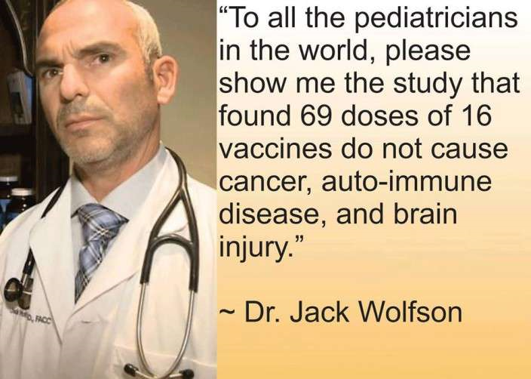

Slide 21
Ingredients of Vaccines
Preservatives
(neurological damage)
Antibiotics
(allergies/anaphylaxis)
Aluminium adjuvant
Human Foetal Cells
(autoimmune diseases)
Mercury compounds, (thimerosal) formaldehyde, phenoxyethanol
Neomyacin, streptomycin
Aluminium hydroxide
Aluminium phosphate
Polysorbate 80, Gelatin
Phenol etc.

Slide 22
Increase in Morbidity: 5-fold
Autism
Childhood Cancer
Autoimmune
Diabetes
Arthritis
Thyroid Problems
Multiple Sclerosis
Lupus
Chronic Fatigue Syndrome
Parkinson
Etc.
Coeliac disease
Food allergies
Anaphylaxis
Asthma
Eczema
Neurological disorders
Speech delay
Learning/behavioral difficulties/ADHD
Seizures/convulsions
Palsies etc.

Slide 23
2005 GAVI
The claim by the GAVI alliance for decades that:
‘much of the burden of infectious diseases can be alleviated if every child has access to multiple vaccines’
is untrue and a serious risk to human health and humanity.
And this COVID injection is not a true Vaccine.

Slide 24
COVID19: The Creation of an Alleged ‘Pandemic’
Judy Wilyman PhD
Independent Researcher and Educator

Slide 25
Creating a ‘Pandemic’
Diagnosis is a Grey Area of Science
Changes to Diagnostic Criteria and Surveillance are the key to creating a ‘Pandemic’.
International Classification of Diseases – new category of “flu-like illness” called COVID19 Disease (2020)
2020 PCR test only tests for SARSCov-2 (flu disappeared) to find ‘cases’.
Statistics can hide many factors – context is critical to causality but no transparency for public

Slide 26
Risk of Disease after 1950
Risk of a disease to the community can only be determined from death and hospitalisation statistics in specific demographics – not cases (incidence) of disease in the community.
Case-fatality ratio in each demographic.
[MacFarlane Burnet 1952]

Slide 27
Definition of a Pandemic
2009 Prior to May
“An influenza pandemic may occur when a new influenza virus appears against which the human population has no immunity resulting in epidemics worldwide with enormous numbers of deaths and illness.”
[Parliamentary Assembly Council of Europe]

Slide 28
New Pandemic Definition
After 4 May 2009
“An epidemic occurs when there are more cases of that disease than normal. A pandemic is a worldwide epidemic of a disease.…….”
[Parliamentary Assembly Council of Europe]

Slide 29
A Pandemic of PCR Testing
Healthy people should never be considered a ‘case’ of disease.
Fraudulent PCR testing
Risk is only determined by hospitalisations and deaths – Not cases after 1950.
Non-serious cases of disease do not indicate the risk of a virus to the community
INDUSTRY PSEUDOSCIENCE

Slide 30
2020 Directives
Healthy People:
Lockdowns
Social Distancing
Alcoholic Hand Sanitiser
Isolation of Elderly
Quarantining 14+days
Masks
Invasive PCR Tests
Experimental Vaccine
The New Norm

Slide 31
Creating a Pandemic
Create a new category of Flu 2020
Definition of ‘Pandemic’ changed May 2009 ‘Cases’ not ‘Hospitalisations and Deaths’
Industry Mathematical Model with false assumptions to predict deaths
Change reporting of deaths 2020
Media Fear campaign – Co-morbidity/elderly
‘Cases’ are healthy people – tested positive (2020)
PCR tests do not identify an infection (the disease) – only a segment of viral material.
A Cycle Threshold for amplifications of 30+ is potentially 100% false positives (Australia 40-45)
Claim to the World that you have prevented a ‘pandemic’ by closing the borders – Scott Morrison.

Slide 32
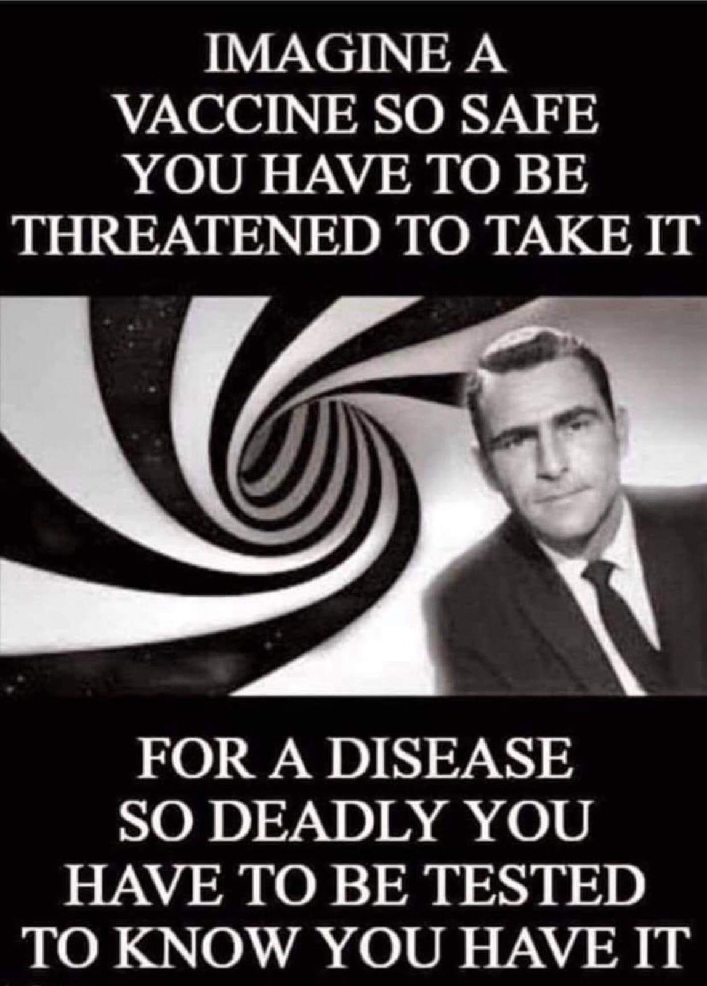

Slide 33
Pandemic of a Virus or a PCR Test?
No Australian data to claim a ‘pandemic’ in 2020 (Emergency Powers triggered January 21st).
Flu deaths in the elderly down, COVID19 Up (2020 PCR test only)
Annual mortality for flu within the normal range for every country
The government funded hospitals to set up hundreds of PCR testing clinics for healthy people.
Vaccine introduced March 2021: i) Reduced testing ii) Reduced CT iii) allow the use of Ivermectin and other treatments
‘Cases’ in the media are healthy people who have been tested
Is everyone at risk when they are exposed to a virus?
NO – INDUSTRY PSEUDOSCIENCE

Slide 34
Not A Vaccine
WHO criteria for a ‘vaccine’ not fulfilled
This is new genetic technology that inserts nucleic acid (mRNA) that uses our cells to produce a toxic spike protein
Synthetic spike protein not specific to Coronavirus 2019 (SARSCov-2) (ADE after re-exposure)
Many toxic ingredients and unknown ingredients
Experimentation on humans - unmonitored

Slide 35
Adverse- Events
Anaphylaxis, rash, respiratory symptoms (First 10-30 mins due to Polyethylene Glycol (PEG)).
Lipid nanoparticles accumulate in ovaries. Toxic to humans
Increased inflammation, thrombosis (blood clots), allergies, heart attacks, seizures, myocarditis, pericarditis, autoimmunity, infertility, neurological damage, cognitive dysfunction, etc.
Antibody-Dependent Enhancement (ADE) In animals Cytokine Storm observed when re-exposed to natural virus (destroys cells and organs – leads to death).

Slide 36
Vaccine Deaths and Injury
European Union Database:
26,595 Deaths + 2.5 million Vaccine Injuries (9 months)
US VAERS:
150,000 Deaths + Millions Vaccine Injuries (9 months)
UK Yellow Card:
1,662 Deaths + 1,200,579 Vaccine Injuries (9 months)
Australian TGA:
524 Deaths + >57,000 Vaccine Injuries (6 months)

Slide 37
Statistics 2021
Deaths and hospitalisations increased in 2021in the most vaccinated nations (ADE)
In all age-groups not just the elderly as in 2020 (only difference is the injection)
The reporting of deaths is non-transparent and media controls the narrative.

Slide 38
Reporting
2020 the reporting of cause of death was changed – primary and secondary cause.
2020 PCR only tests for Coronavirus 2019 (SARSCov-2) not Flu.
Doctors are NOT allowed to put ‘vaccine’ as the cause of any death or illness. Why?
2021 the definition of ‘vaccination’ was changed by CDC to 2 weeks after receiving the vaccine.
No transparency or accountability for government or doctors.

Slide 40
Conclusion
Allopathic medicine uses the capitalist economic model of health that profits from our health.
Coercive medication and the removal of autonomy – doctors and patients cannot promote ‘Health’
Reversal of medical ethics - genetics
The Sickness Industry – Not Health Promotion

Slide 41
Action Plan
Saying No
COVID Medical Network – Open Letter Re Informed Consent to all Medical Doctors. www.covidmedicalnetwork.com
People for Safe Vaccines – COVID19 Vaccine Declination Form and other template letters. Do not resign. Take leave. www.peopleforsafevaccines.org
Advocate Me (Legal Advocacy)
www.advocateme.com.au
Human Rights Advocates https://humanrightsadvocates.com.au
Ashley, Francina & Leonard(AFL) https://www.aflsolicitors.com.au/index.html
International Criminal Court – Reiner Fuellmich (Crime Against Humanity) Medical Ethics

Slide 42
1. People for Safe Vaccines
www.peopleforsafevaccines.org
2. Australian COVID Medical Network
www.covidmedicalnetwork.com
3. Vaccination Decisions
www.vaccinationdecisions.net
4. Vaccine Choice Australia
www.vaccinechoiceaustralia.com.au
5. Australian Vaccination-risks Network
www.avn.org.au

