Slide 1
The Rule of Law & Constitutionalism
Prof Augusto Zimmermann PhD, LLB, LLM, CIArb

Slide 2
What is the Rule of Law?
Although its meaning is always open to debate, this ideal of legality is undoubtedly concerned with…
protecting individuals from unpredictable and arbitrary interference with their vital interests

Slide 3
A Solution to the Problem of Political Tyranny
The rule of law denies governments any ‘right to destroy, enslave, or designedly to impoverish the subjects’.[1]
It implies that government acts through law and that law checks the power of government
[1] John Locke, Second Treatise on Civil Government (1689). Sec.135.

Slide 4
The idea is associated with a classical liberal tradition of constitutional government and protection of fundamental rights

Slide 5
“Historically, the phrase [Rule of Law] was used with reference to a belief in the existence of law possessing higher authority – whether divine or natural – than that of the law promulgated by human rulers which imposed limits on their power… Bracton, writing in the thirteenth century, adopted the theory generally held in the Middle Ages that ‘the King himself ought not be subject to man but subject to God and to the law, because the law makes him king’. The same view is also expressed in the Year of the Books of the fourteenth and fifteenth centuries. Such superior law governed kings as well as subjects and set limits to the prerogative. On that ground Fortescue, in the middle of the fifteenth century, based his argument that there could be no taxation without representation”.
O.H. Phillips and P. Johnson, O. Hood Phillips’ Constitutional and Administrative Law (1987), 37.

Slide 6
Henry de Bracton (c.1210 – 1268)
Justice of the King’s Bench
His De Legibus et Consuetudinibus Angliae, is the first systematic treatment of the English common law
The treatise earned him the title as “Father of the Common Law”
Bracton's De legibus et consuetudinibus Angliae (1300)

Slide 7
“The king shall be under God and the law, because the law makes the king. For there is no king where will rules rather than the law.”
– Henry De Bracton, On the Laws and Customs of England (Harvard University Press, 1968) 25.

Slide 8
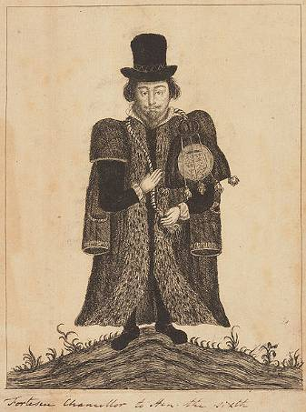
Sir John Fortescue (c.1394-c.1480)
Chief-Justice of the King’s Bench
His De laudibus legum Angliae is deemed a “masterly vindication of the laws of England”

Slide 9
“For the king of England is not able to change the laws of his kingdom at pleasure, for he rules his people with a government not only regal but also political” . – John Fortescue

Slide 10
“A law is necessarily adjudged cruel, if it increases servitude and diminishes freedom, for which human nature always craves. For servitude was introduced by men for vicious purposes. But freedom was instilled into human nature by God. Hence freedom taken away from man always desires to return, as is always the case when natural liberty is denied. So he who does not favour liberty is to be deemed impious and cruel. In considering these matters the laws of England [must] favour liberty in every case”.
Sir John Fortescue, De Laudibus Legum Anglie, c.42.

Slide 11
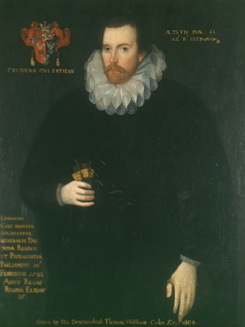
Sir Edward Coke (1552-1634)
He is called ‘The Shakespeare of the Common Law’
Famously quoted from Bracton to remind King James that “the King must be under God and the Law”

Slide 12
“And it appears in our books, that in many cases the common law will controul acts of Parliament, and sometimes adjudge them to be utterly void; for when an act of Parliament is against common right and reason, or repugnant, or impossible to be performed, the common law will controul it and adjudge such act to be void”.
Bonham’s Case 8 Co. Rep. 114

Slide 13
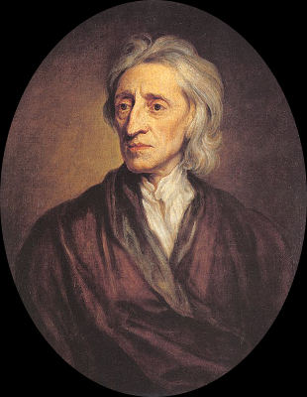
John Locke (1634-1704)
His work played a fundamental role in the development of constitutionalism
Locke’s work provided the philosophical justification for the UK Glorious Revolution (1688) and the American Independence (1776)

Slide 14
John Locke, The Second Treatise of Government Chapter Six: Of Paternal Power
The end of law is not to abolish or restrain but to preserve and enlarge freedom. For in all states of created beings capable of laws, where there is no law there is no freedom. For liberty is to be free from restraint and violence from others, which cannot be where there is no law.

Slide 15
“Whenever the legislators endeavour to take away and destroy the property of the people [i.e., their rights to life, liberty and property], or to reduce them to slavery under arbitrary power, they put themselves into a state of war with the people, who are thereupon absolved from any further obedience, and are left to the common refuge which God hath provided for all men against force and violence”.
John Locke, Second Treatise on Civil Government, Chapter 19.

Slide 16
The following elements are considered necessary for the realisation of the rule of law…

Slide 17
1) Laws against private coercion
Lawless violence inflicted by citizens on other fellow citizens is as much antithetical to the rule of law as political tyranny

Slide 18
2) Laws should be clear, certain, adequately publicised and normally prospective
When a law is unclear, uncertain, or not adequately publicised, we can’t know what it requires
We would be left unable to conduct our affairs with security, owing to a lack of knowledge about the content of laws affecting ourselves

Slide 19
3) The rule of law implies a generality of law
Laws should not be directed to a single person or group, but apply to everyone regardless of race, gender or ethnicity
Generality does not require that every law possess universal application, but it implies a non-arbitrary basis for differential treatment

Slide 20
4) Laws should be as stable as possible
Legal stability allows us to know which laws we have to comply. It allows us to plan our lives according to proper rules
The aim of stability is to facilitate personal planning and a fruitful interaction among fellow citizens

Slide 21
5) Laws limiting, controlling and guiding the exercise of official discretion
Government actions must be regulated by common standards of legal conduct
The legitimacy of government resides in the exercise of power according to clear rules and principles

Slide 22
6) The courts must be independent, impartial, and accessible to everyone
Citizens have the right to submit legal complaints before an impartial and independent judiciary
Access to the court system should occur without long delays, corruption or excessive costs in filing a lawsuit

Slide 23
7) The rule of law does not authorise court decisions expressing the arbitrary will of judges
Judicial independence is important for the impartial administration of justice
Judges must respect rules and principles every time they make decisions

Slide 24
Former HC Chief-Justice Murray Gleeson
“Judges are appointed to interpret and apply the values inherent in the law. Within the limits of the legal method, they may disagree about those values. But they have no right to throw off the constraints of legal methodology. In particular, they have no right to base their decisions about the validity of legislation upon their personal approval or disapproval of the policy of the legislation. When they do so, they forfeit their legitimacy.”
Murray Gleeson, The Rule of Law and the Constitution. 2000 Boyer Lectures, Sydney: ABC Books, 2000, p.134.

Slide 25
Culture of Legality
The practical realisation of the rule of law requires a culture of legality
encompasses a social context in which ordinary citizens and public officials manifest a serious commitment to elements of the rule of law

Slide 26
Martin Krygier, ‘Compared to What?’ Quadrant, December 1993
[52] It is hard to provide a recipe for producing the rule of law, and often it has thrived best where it was least designed. Even if you could come up with a recipe based upon some successful example or other, it is unclear whether it would travel well. It is quite clear that the rule of law is as much a social and political achievement as it is a legal one.

Slide 27
A meta-legal doctrine
The rule of law is a meta-legal doctrine about what laws ought to be
This ideal of legality is essentially related to conditions of liberty

Slide 28
F.A. Hayek The Constitution of Liberty (Chicago University Press, 1960)
[205] The rule of law means that government must never coerce an individual except in the enforcement of a known rule. It constitutes a limitation on the powers of all government, including the powers of the legislature. It is a doctrine concerning what the law ought to be, concerning the general attributes that particular laws should possess…

Slide 29
(Cont.) This is important because today the conception of the rule of law is sometimes confused with the requirement of mere legality in all government action. The rule of law, of course, presupposes complete legality, but this is not enough: if a law gave the government unlimited power to act as it pleased, all its actions would be legal, but it would certainly not be under the rule of law. The rule of law, therefore… requires that all laws conform to certain principles.

Slide 30
T.R.S. Allan, Law, Liberty and Justice (Oxford University Press, 1993)
[21] In the mouth of a British constitutional lawyer, the term ‘rule of law’ seems to mean primarily a corpus of basic principles and values, which together lend some stability and coherence to the legal order. It expresses his commitment to a scheme of ideas regarded as legally fundamental...

Slide 31
(Cont.) The rule of law is an amalgam of standards, expectations, and aspirations: it encompasses traditional ideas about the requirements of justice and fairness in the relations between government and governed. Nor can substantive and procedural fairness be easily distinguished: each is premised on respect for the dignity of the individual person… Allegiance to the rule of law is not, therefore, a technical (even ‘lawyerly’) commitment: it is necessarily allegiance to a political philosophy – albeit a practical philosophy grounded in existing constitutional tradition.

Slide 32
The rule of law is about… “a common ideal shared and unquestionably accepted by the majority”
Hayek argues: “The rule of law will not prevail unless it forms part of the moral tradition of the community”

Slide 33
F.A. Hayek The Constitution of Liberty Chicago University Press, 1960
[205]From the fact that the rule of law is a limitation upon all legislation, it follows that it cannot itself be a law in the same sense as the laws passed by the legislator… The rule of law is therefore not a rule of the law, but a rule concerning what the law ought to be, a meta-legal doctrine or a political ideal. It will be effective only in so far as the legislator feels bound by it. In a democracy this means that it will not prevail unless it forms part of the moral tradition of the community, a common ideal shared and unquestionably accepted by the majority…

Slide 34
(Cont.) it is this fact that makes so very ominous the persistent attacks on the principle of the rule of law. The danger is all the greater because many of the applications of the rule of law are also ideals which we can hope to approach very closely but can never fully realize. If the ideal of the rule of law is a firm element of public opinion, legislation and jurisdiction tend to approach it more and more closely. But if it is represented as an impracticable and even undesirable ideal and people cease to strive for its realization, it will rapidly disappear. Such a society will quickly relapse into a state of arbitrary tyranny. This is what has been threatening during the last two or three generations throughout the Western world.

Slide 35
In other words…
The rule of law depends as much on social-cultural-political characteristics of society as of the positive law itself, and on their interactions

Slide 36
“Positive laws may sometimes be an advance on otherwise unregulated tyranny. Promulgations and other virtues of legal formalism often advance the empire of laws. But they are only secondary and contingent to the requirements of the rule of law, not the thing itself”.
- Professor Mortimer Sellers (former President of the International Association for Philosophy of Law and Social Philosophy)

Slide 37
Constitutionalism is a derivative of Rule-of-Law thought

Slide 38
Suri Ratnapala, Australian Constitutional Law: Foundations and Theory Oxford University Press, 2002, p 7
A Constitution in the philosophical sense is a constitution of a particular type. It limits the powers of rulers by subordinating them to enduring rules that they themselves cannot abrogate. Such a constitution is inextricably associated with the ideal of the Rule of Law, which seeks to ensure that people are not at the mercy of the momentary will of a ruler or a ruling group, but enjoy stability of life, liberty and property.

Slide 39
What is a Constitution?
Constitution is the nation’s fundamental law – governing the legislative, executive, and judicial functions of the State

Slide 40
Declaration of the Rights of Man and the Citizen (National Assembly of France, 26 August 1789)
Art.16: “A society in which the guarantee of individual rights is not assured, nor the separation of powers defined, has no constitution at all”.

Slide 41
Thomas M. Cooley The General Principles of Constitutional Law Boston: Little Brown and Co., 1898, p 22
Although every state may be said in some sense to have a constitution, the term constitutional government is only applied to those whose fundamental rules or maxims that impose efficient restraints on its exercise for the purpose of protecting individual rights and shielding them against any assumption of arbitrary power.

Slide 42
Constitutional government requires a “culture of constitutionalism”

Slide 43
Suri Ratnapala et al, Australian Constitutional Law Oxford University Press, 2007, p 4
“Constitutional government needs much more than a well-written constitution. The best constitution is to no avail if it does not command the respect of official and citizens. Hence this form of government is unsustainable without a proper culture of constitutionalism. Such culture depends in part on favourable historical, social and economic conditions”.

Slide 44
Separation of Powers
“Power corrupts and absolute power corrupts absolutely”
– Lord Acton
“To prevent this abuse, it is necessary from the very nature
of things that power should be a check to power”
– Baron de Montesquieu
“All power is likely to be abused unless it is adequately
checked”
– Sir Ivor Jennings

Slide 45
Baron de Montesquieu, The Spirit of the Laws (1748) Book XI, Chapter VI
“When the legislative and executive powers are united in the same person, or in the same body of magistrates, there can be no liberty; because apprehensions may arise, lest the same ruler or legislator should enact tyrannical laws, to execute them in a tyrannical manner.”

Slide 46
A pure doctrine of separation of powers might be formulated in the following way…

Slide 47
“It is essential for the establishment and maintenance of political liberty that the government be divided into three branches or departments, the legislature, the executive, and the judiciary. To each of these three branches there is a corresponding identifiable function of government, legislative, executive, or judicial. Each branch of the government must be confined to the exercise of its own function and not allowed to encroach upon the function of the other branches. Furthermore, the persons who compose these three branches of government must be kept separate and distinct, no individual being allowed to be at the same time a member of more than one branch. In this way each of the branches will be a check to the others and no single group of people will be able to control the machinery of the State”.
- M. J. C. Vile (Professor Emeritus of Political Scince at the University of Kent) Constitutionalism and Separation of Powers (2nd ed.) 14.

Slide 48
No Separation of Powers in Australia
The Westminister System is a parliamentary system originally developed in the United Kingdom.
This results in a member of Parliament (prime minister or premier) who heads the government, and a ministry enterily comprised of members exclusively drawn from Parliament, which exercises executive authority.

Slide 49
The Governor General (or Governor) is appointed by the King on the advice of the Prime Minister (or Premier) to be the Head of State.
One of the powers that the Governor-General (or Governor) theoretically exercises under Section 59 is that of desallowing (vetoing) legislation passed in Parliament
However...
“The power of disallowance is now a dead letter. This section is among the inoperative sections in the Constitution”

Slide 50
Who is the governor-general (governor) is really representing in our current system of government?
One wonders how “neutral” and “apolitical” a Head of State really is now that not only retired politicians but also a “Chief Health Officer” and a “Vaccine Commander” are appointed the governors of Queensland and Western Australia, respectively.

Slide 51
How Concentration of Powers Undermine The Rule of Law in Australia

Slide 52
Under our parliamentary system of government, there is no proper separation of powers
The vast concentration of powers in the hand of a few facilitates the undermining of the Rule of Law.

Slide 53
“Under contemporary conditions of parliamentary government, there is a tendency for both executive and legislative power to be concentrated effectively in a very small group of senior ministers, dominated by the prime minister or premier”.
- Prof. Nicholas Aroney (University of Queensland)

Slide 54
To make it worse, the courts have chosen to not draw the line in the sand against excessive delegation of legislative power to the executive despite parliamentary democracies relying heavily on judicial oversight of executive action.

Slide 55
“The High Court, despite having full judicial power, has declined to impose on Parliament any significant constraint on its competence to delegate its legislative power to the executive”.
- Emeritus Professor Suri Ratnapala

Slide 56
“There is no constitutional impediment to the exercise by one branch of government of the powers of another. No statute can be held invalid because it confers powers of one kind on an instrumentality of another kind … The executive and the legislature are closely connected.”
- Sir Harry Gibbs (former Chief Justice of the High Court)

Slide 57
This means that any Parliament in Austraila may repose in the executive a function that is essentially legislative in nature.
“It is indeed difficult to reconcile these decisions with an acceptance of the principle of separation of powers”.
- Sir Harry Gibbs

Slide 58
There is no real separation of powers in Australia. In fact, even judges are not entirely independent since they are ultimately appointed by the government of the day
The negative consequence of such concentration of powers is demonstrated by the lack of proper judicial scrutiny of executive orders that violate the most basic principles of the Rule of Law.
It is no wonder, therefore, why so many fundamental rights can be so easily ignored and violated.

Slide 59
Over the last three years the Australian governments have exercise coercive powers over its citizens on a scale never previously attempted.
For months they forced mandatory vaccination and placed everyone under house arrest, qualified only by a limited number of things approved by the authorities.
Unfortunately, such disdain for the Rule of Law does not come as a surprise for those who knows how the doctrine of parliamentary sovereignty operates.

Slide 60
Parliament Sovereignty
“Parliament is competent to make any law on any matter of its choosing and no court many question the validity of any Act that it passes”.
UK Government (Cm 3782, 1997) para. 2.13
In other words, no right is deemed strictly fundamental because of the supposed “sovereignty of Parliament”.

Slide 61
“There are under the constitution of the United Kingdom no rights strictly fundamental, in the sense of entrenched (basic, inalienable), because of the supremacy of Parliament”.
- Sir Owen Hood Phillips KC (Emeritus Professor of Jurisprudence)

Slide 62
“The foundational principle of the constitution is the sovereignty of the Parliament… This sovereignty means that Parliament is competent to make or unmake any law on any topic and the courts are required to give effect to those laws. Under the classical model of the UK’s constitution there are thus no legal limits to what Parliament may do by primary legislation, including altering the period between general elections and amending or repealing protecting individual rights … Some consider such legal sovereignty to be incompatible with the rule of law, and there are certainly tensions between the two, and between it and the principle of separation of powers”.
Jack Beatson, The Rule of Law and The Separation of Powers, 6-7

Slide 63
The Rt. Hon Sir Jack Benson (High Court Judge between 2003 and 2013 and a Lord Justice of Appeal between 2013 and 2018. He was previously Law Commissioner and Rouse Ball Professor of English Law at the University of Cambridge and is now Visiting Professor at Oxford University

Slide 64
In other words, under the doctrine of parliamentary sovereignty no judicial body can question the validity of an act on grounds of its violation of fundamental human rights.
This understanding is confirmed by Tom Bingham, the late Lord Justice of England and Wales

Slide 65
Tom Bingham, The Rule of Law (Penguin Books, 2011) 12
“The courts have no inherent powers to strike down, supersede or disregard the provisions of an unambiguous statute duly enacted by the [King] in Parliament, and indeed, an extremely limited power to enquire whether a statute has been duly enacted. For Parliament may under our constitution enact any legislation it chooses, and no court has any power to annul or modify such enactment, it necessarily follows that Parliament can legislate so as to abrogate or infringe any human right, not matter how fundamental it may be thought to be”.

Slide 66
Due to the practical implications of “parliamentary sovereignty”, the effect is that government is unaccountable to one, except once in a couple of years at general elections.
So, it is no wonder why so many fundamental rights have been ignored or violated over the last years.
The present constitutional model based on ‘parliamentary sovereignty’ (and lack of separation of powers) inevitably facilitates what Lord Hailsham described in his 1976 Dimbleby Lecture as an elective dictatorship

Slide 67
“The functions of the legislature and the executive are closely related. Ministers are also members of Parliament and, save in the rare case of a ‘hung’ Parliament, a coalition or a minority government, or acute internal divisions within the majority party, the executive controls the House of Commons. And since the Parliament Act 1911 the House of Lords has had no veto power over legislation, only a delaying power shortened by the Parliament Act 1949 to one year or, in the case of money bills, one month, the executive generally controls the legislative process. Our institutional arrangements and the principle of Parliamentary sovereignty have therefore created what Lord Hailsham described as an ‘elective dictatorship’.
- The Rt. Hon Sir Jack Beatson

Slide 68
“Parliamentary sovereignty is incompatible with another concept which also has a lengthy history, but which today is widely regarded as a paramount value: The Rule of Law”.
- Sir Francis Jacobs (Law Professor, King’s College London)

Slide 69
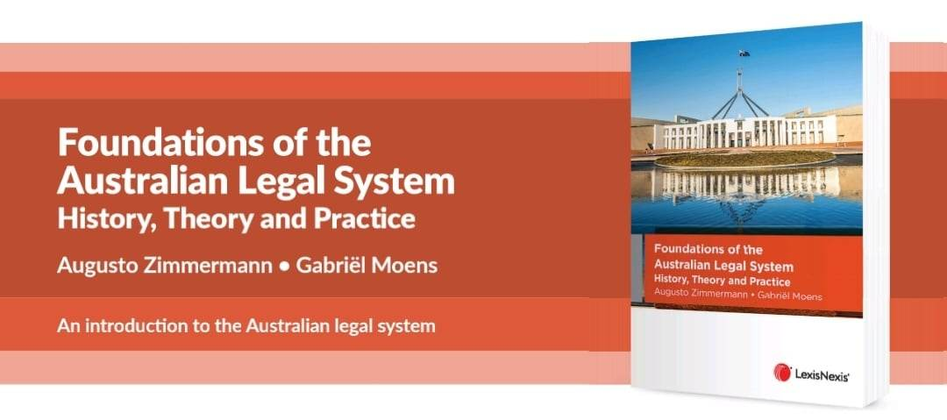
For more information…

