Slide 1
We the People State of our Constitution Government Integrity in South Australia
Adelaide Conservative
Speakers Club
Lecture 1: 1 July 2023
Speaker 2: Robert Balzola
Stanford House
207 East Terrace Adelaide
1 – 2 July 2023

Slide 2
DAY 1 Government Integrity in South Australia
South Australian Retrospective Legislation
Abnegation of Responsible Government
Enforcement and Remedies

Slide 3
“We the People”
Preamble to the Constitution of the
United States of America
‘We the People of the United States, in Order to form a more perfect Union, establish Justice, insure domestic Tranquility, provide for the common defence, promote the general Welfare, and secure the Blessings of Liberty to ourselves and our Posterity, do ordain and establish this Constitution for the United States of America.’

Slide 4
Section 1 Commonwealth Constitution
An Act to constitute the Commonwealth of Australia
WHEREAS the people of New South Wales, Victoria, South Australia, Queensland, and Tasmania, humbly relying on the blessing of Almighty God, have agreed to unite in one indissoluble Federal Commonwealth under the Crown of the United Kingdom of Great Britain and Ireland, and under the Constitution hereby established:
And whereas it is expedient to provide for the admission into the Commonwealth of other Australasian Colonies and possessions of the Queen:
Be it therefore enacted by the Queen’s most Excellent Majesty, by and with the advice and consent of the Lords Spiritual and Temporal, and Commons, in this present Parliament assembled, and by the authority of the same, as follows:—

Slide 5
US – Australian Constitutional Comparison
People: Franchise
Under God
States
Australian Constitution modelled on US Constitution
Noted distinction on Separation of Powers
Christian Commonwealth
Sir John Downer’s Constitutional Referendum Speech 3 March 1898

Slide 6
Distinction between US / Australian Powers
US and Australian Constitutions diverge in power
Separation of Powers Legislature, Judicature, Executive
Executive in Australia vests in Crown
Executive in US vests in President
Judicature: Method of appointment & Tenure
Legislature: Method of election

Slide 7
Elements of Democracy
Elected franchise
Subsidiarity and Solidarity
Responsible Government
Separation of Powers
Independence of all three arms of Government

Slide 8
The South Australian Experiment
Premier Annastacia Palaszczuk shrugs off resignation of Queensland's integrity watchdog
By state political reporter Rachel Riga
Posted Mon 24 Jan 2022 at 7:26pmMonday 24 Jan 2022 at 7:26pm, updated Thu 27 Jan 2022 at 7:25pmThursday 27 Jan 2022 at 7:25pm
Atypical of rest of Australia
Nothing unique about South Australia
Elected politicians
Unelected bureaucrats
Rule of Law
Responsible Government

Slide 9
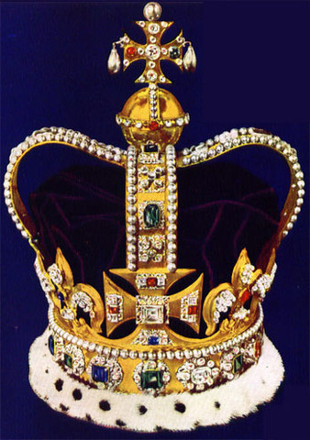
Who is the Executive?
The Crown
In reality, unelected faceless bureaucrats
Administrative accountability
Removal of Privy Council
No equivalent in Australia
Senate oversight
Peer review

Slide 10
Administerialism
Government by bureaucracy
Arrogation of power by administration in name of Executive
How is accountability maintained?
Political accountability via Legislature
Legal accountability via Courts

Slide 11
How Three Arms Check and Balance
EXECUTIVE
LEGISLATURE
JUDICATURE

Slide 12
Powers, Principalities, Thrones and Kingdoms
Legislature controls via
Legislative instruments e.g.
Acts
Regulations
Administrative Arrangements
Executive controls via
Executive oversight
Prerogative
Judicature controls via
Common law
Inquiries

Slide 13
Tectonic friction
Three Arms collide
Constant power play arrogating power
Centralisation of power
New South Wales Super Ministries
Morrison assumption of Ministries
1984 ‘Power Power Power’
ABC News 25 November 2022

Slide 14
Recent New South Wales Experience
‘Goodbye to Bureaucratic oversight’ caption
Eight Super Ministries
Failed experiment of Ministerial control over Departments

Slide 15
Source ABC News

Slide 16
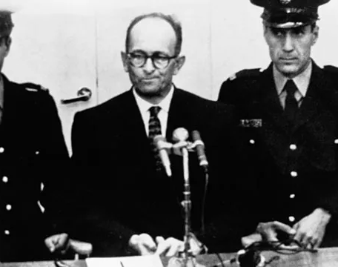
Eichmann Trial Court of Jerusalem 1961
Retrospective laws applied
Ex post facto defence
Multiple counts of crimes against Jews.

Slide 17
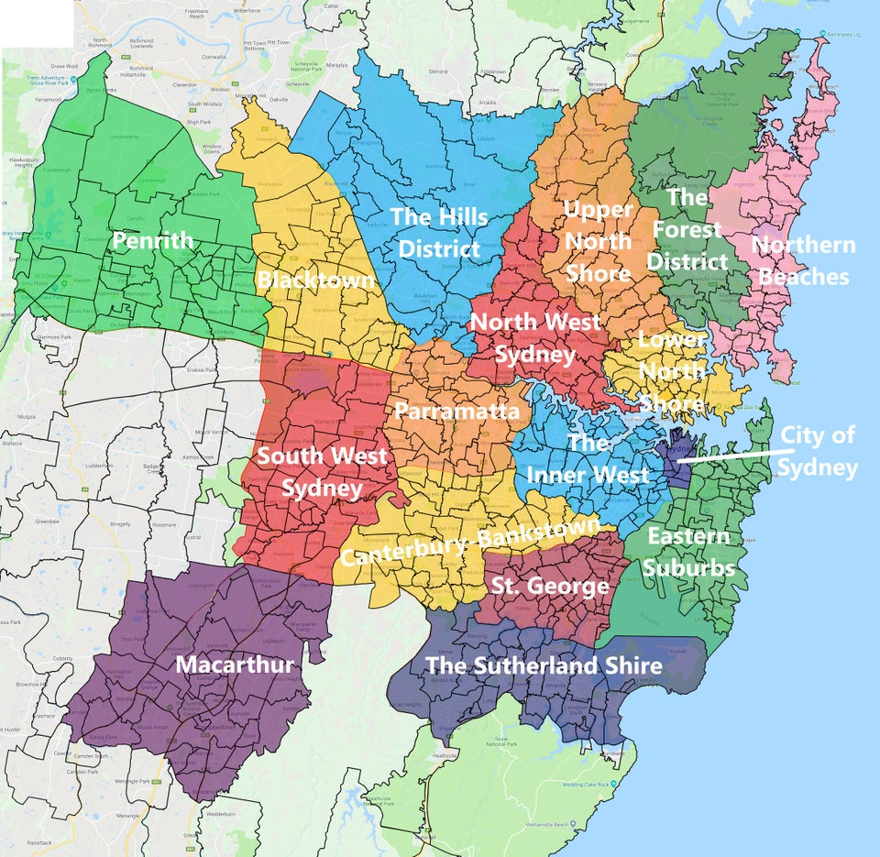
Local Government Areas Sydney

Slide 18
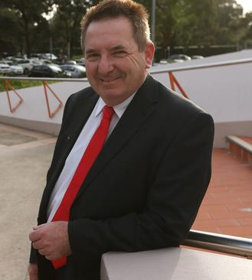
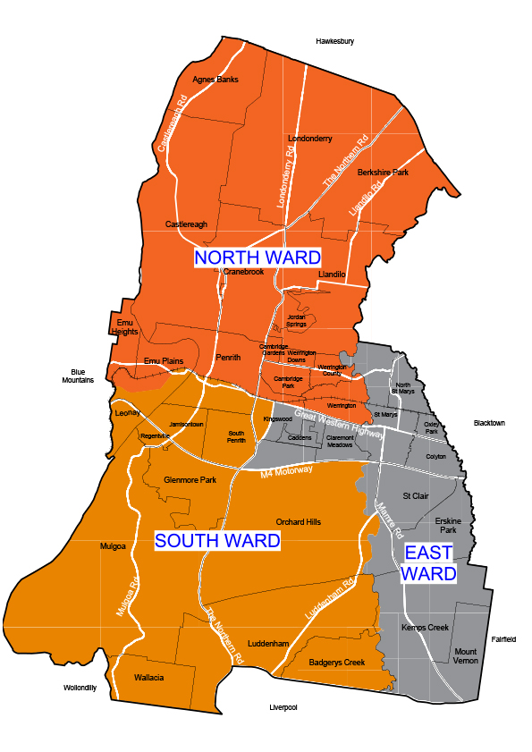
[1] Penrith City Council Case Study 2014 – Present : Cr Marcus Cornish
2014 Complaint
2017 NCAT 1
2018 Sup Ct NSW
2022 NCAT 2
2023 NCAT 3

Slide 19
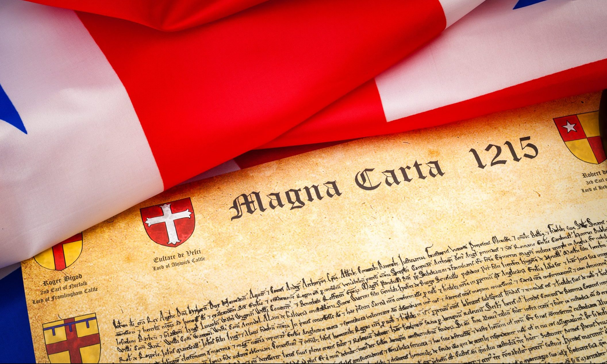
Micro-Management ‘Catch me if you can’

Slide 20
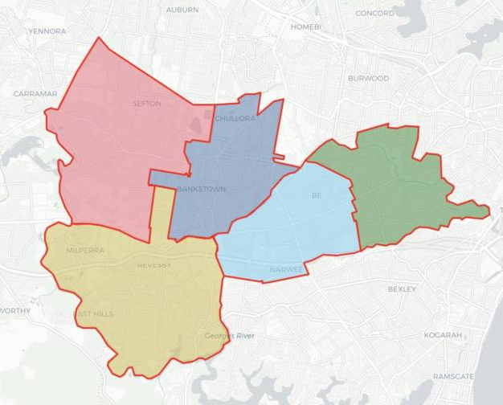
[2] Canterbury-Bankstown City Council Case Study 2022 – Present Cr Barbara Coorey
2022 Multiple complaints
WHSA and Code of Conduct breaches complaints in quick succession
Referral to NCAT and Supreme Court

Slide 21
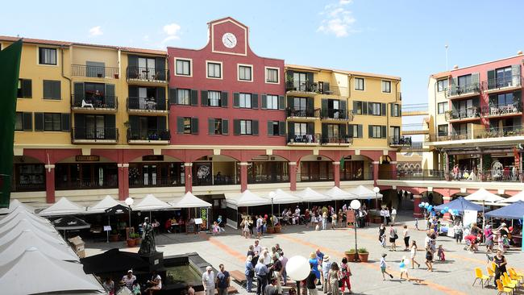
[3] Italian Forum Leichhardt New South Wales

Slide 22
Retrospectivity and Accountability
No deterrence
No application of rule of law
Retrospective amelioration denies transparency
Voting without knowledge of pecuniary interests

Slide 23
Parabellum – Deterrence – Enforcement
Movement not Politics
Enforcement by statutory and civil means
Responsibility by just punishment
Deterrence against offences in Public Office

Slide 24
Emotive reactions to Law
Deterrence
Servile Fear
Risk of personal liaibility
Quotes of 2023 to date
‘Are we going to lose our houses’? Answer in Chambers: Yes.
‘They are shitting themselves’. Quote from this morning.

Slide 25
Tomorrow’s address – Remedies
Concept of Movement
Higher purpose
Spot issues
Applied politics, morality and philosophy
What ideology drives your movement?
Joining the dots
Recreating the Little Republics
Role of the Public Schools Club, ALOR, Conservative Speaker Group

Slide 26
Questions

