Slide 1
We the People 2 State of our Constitution Government Integrity in South Australia
Adelaide Conservative Speakers Club
Lecture 2: 2 July 2023
Speaker 2: Robert Balzola
Stanford House
207 East Terrace Adelaide
1 – 2 July 2023

Slide 2
Recap from yesterday
Government integrity in South Australia and the Commonwealth
Preamble of Constitution
Elements of Democracy
Who is the Executive?
Administerialism
Three arms of Government
Case studies
What is to be done?

Slide 3
subversion INFILTRATE – UNDERMINE - OVERTHROW
Never resign
Hold ground
Move to recapture moral high ground
Enemy infiltrate, undermine, overthrow

Slide 4
Code of chivalry charter
To engage Evil and destroy it, to ensure it does not prevail to harm others [Lull]
Charter of Infantry: Seize and Occupy Territory
The spiritual war between Good and Evil
Applied warfare in the five fields of diplomacy:
Money
Media
Politics
Law
Social

Slide 5
Movement
Politics is more than running for seats
Politics is movement
Direction changing movement
Election not an end in itself
Mandate means public interest either by right or by numbers
Numbers alone is tyranny

Slide 6
Theatres of war
Politics – Elections and Parliaments
Law – Courts and Tribunals
Media – Newspapers, Internet, Radio, Television
Social – Weaponising women, men, children, alternative genders, the aged, the unborn

Slide 7
The public schools club polemic
No one cares about anything addressed today until it affects YOU.
Pension being cut
Visa not granted
Taxes too high
Land acquisition
Water and electricity prices
Wages
Strata Title disputes
Guardianship, family provision and family law

Slide 8
enforcement
Rule of Law reduces to physical enforcement
Punitive laws
Punishment
Sanction
Fear of economic loss
Bankruptcy and insolvency
Imprisonment
Reputational ruin

Slide 9
Rollback, pushback, enforcement
Burns v Corbett; Burns v Gaynor [2018] HCA 15
Cornish v Secretary, Department of Planning, Industry & Environment [2019] NSWSC 1134

Slide 10
[1] An & ors V abc [vcat h228/2021]
Catch the Fire Ministries 2008
Direct pushback on s.8 Racial and Religious Tolerance Act (Vic) 2008
Using laws in ways inimical to the intended purpose
Coming up for final hearing

Slide 11
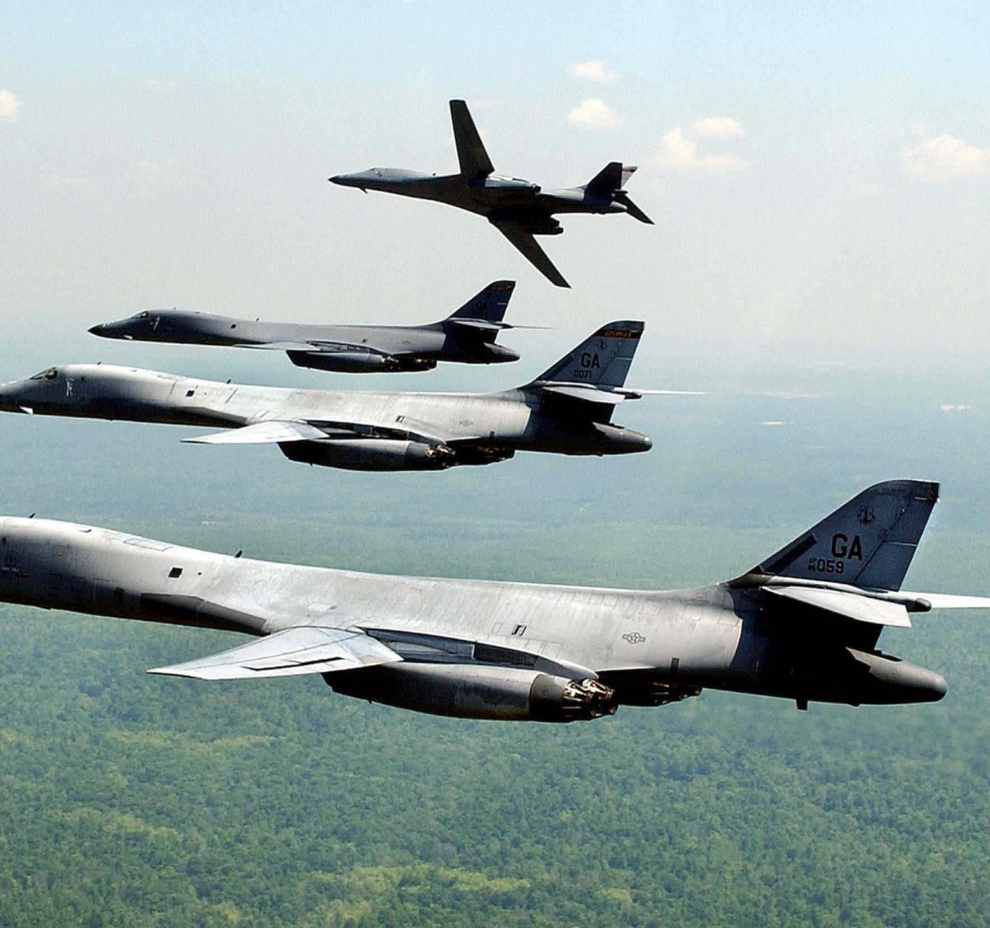
Politics is Over the horizon bomBing
Like over the horizon bombing, you don’t see your enemy
You don’t hear the screams
You don’t see the damage
But you know you hit your targets

Slide 12
subterfuge
Agencies deliberately undermining of agenda by deceit
Marriage a category of this
Infiltration of universities and little republics

Slide 13
Mechanics of activism
ALP most sophisticated political movement currently in Australia
Quasi political entities includes Get Up!, BLM and ANTIFA
Devolution of mainstream political parties
Necessity to train army from diaspora

Slide 14
USE THE LAW AGAINST ITSELF
“We can use these laws”
“You” cannot use the same laws
Apply precedents against the one directional modality to show it up as false
Prosecute, imprison, bankrupt, punish, impede
Counter battery fire

Slide 15
Orwell – horse and flies
Horse only has to shake and the flies fly off its back – Orwell
Law is not “something over there” waving to the Courts
Smug feeling that you are not in court and avoid court at all costs
No fear because of complicity
SS were cowards – fleeing in women’s clothing from Germany
Mass murders
In every case, find the enemy being cowards and losing
Assumption of cowardace, complacency, fat stupid and happy
Need to belong, tribalism

Slide 16
Case studies
Monica Smit & Celina Knowles [VID 579/21]
Sutherland Shire Council v Nick Folkes & Ors [NSD 1601/2015]
Jamal Rifi [NSD 1602/2015]
Bernard Gaynor cases – 41/41 wins
Richards v Hutchinson & Ors [QSC 13242/2020]
Knox v Nile [2018/270818]
Pell group of cases
Sunol cases – 130 complaints, 31 cases
Archbishop Porteous ‘Marriage booklet’

Slide 17
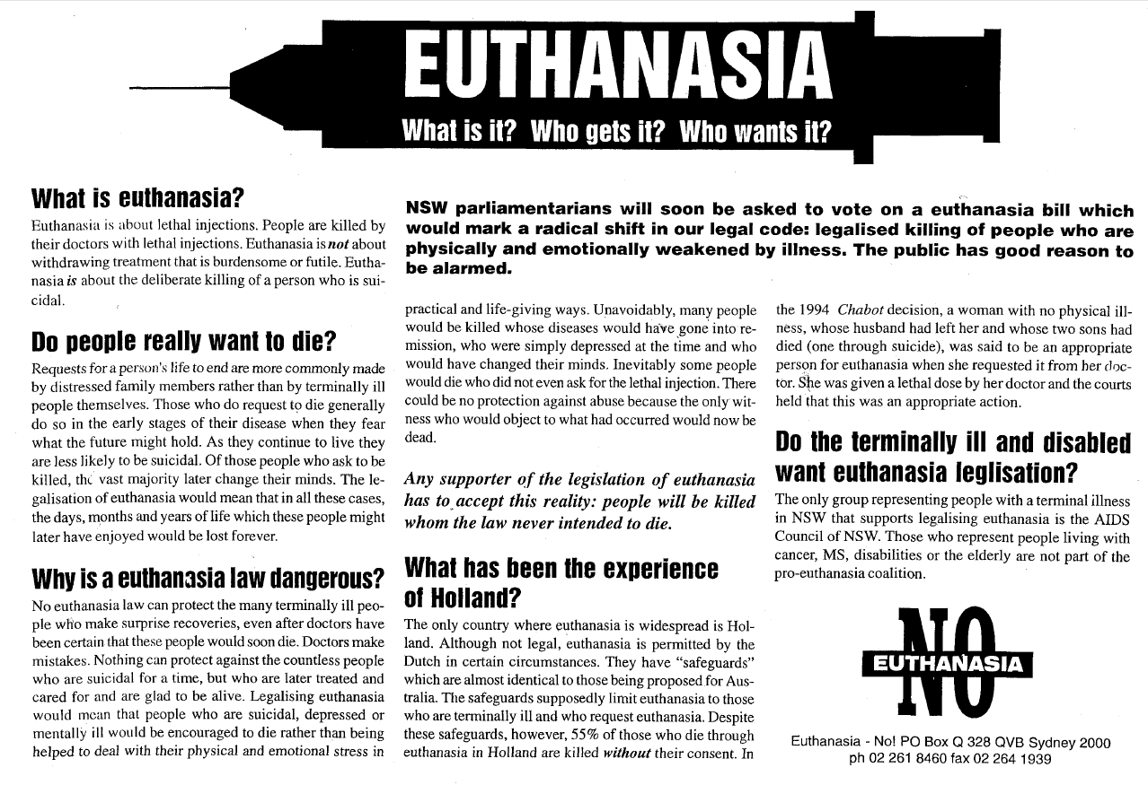
[1] Euthanasia no! campaign 2007

Slide 18
[2] Marriage amendment (definition and religious freedom) act 2017
Postal vote not plebiscite or referendum
Breach s.128 Commonwealth of Australia Constitution Act
The Queen v L [1991] HCA 48
Hyde v Hyde & Woodmansee (1886) [L.R.] 1 P & D 130

Slide 19
[3] Smit (Knowles) v Commonwealth [vid579/2021]
Poorly run litigation
Every argument raised re: conscription, errors of law administrative error argued
Garbage in, Garbage out
John Larter cases in NSW

Slide 20
[4] Body Parts exhibition
Biosecurity Act 2015
Commercial importation of body parts
By-passing of regulatory prohibition
Stopping of this practice in Australia

Slide 21
Current theatres of operation
An & Ors v Australian Broadcasting Corporation [VCAT H228/2021]
Sunol v Kerslake [ACAT AA10/2023]
Gaynor v Burns [NSWSC 2021/261866] & [2022/364275]
Burns v Blyth [ADL037-22]

Slide 22
Plans underway – FREEDOM AUSTRALIA
Incorporated 2021
Front end organization in Knights Service
Peer organisations: Rutherford, Becket Fund, KSC
Secular body
Ready deployment
Standing garrison
Amalgamates RFI and other groupings

Slide 23
Suppressing fire
43 litigations since 2009
Victorious every time
Attacking me is now ‘impractical’
Continuous peppering with litigation against myself
Rolling attempted complaints, reports, criminal charges, torts, media releases
Only now jumping out of the trench
Spent 20 years boning up on law to point of litigation efficiency
Saw appalling incompetency in marriage (2017), abortion (2019), Pell (2017-20) etc.

Slide 24
Restoration, pushback, reclamation
Training – new college for public office aspirants
Support – financial, logistic and political
Media – campaign coordination and liaison
Crowd funding – raising of monies online
Controlled monies and financial compliance
Permanent garrison – ready deployment
Client management and leadership – Burnout, completion, rotation
Legal panel formation
Political leadership formation

Slide 26
Questions

